Slide 1

軟體使用入門

Slide 2

R軟體發展歷史
主要特色及功能
基礎操作
    操作介面
    搜尋幫助
    物件介紹及操作
    常用函數
    基礎繪圖
進階使用
    撰寫程式及函數
    基礎資料分析

Slide 3

R 統計軟體最初是由Ross Ihaka及Robert Gentleman兩人以統計分析及繪圖為目的，仿S語言的架構為基礎而發展出來的統計軟體，可視為改進版本的S語言。大部分的S語言程式碼可直接或稍做修改後就在R上面執行
R屬於GNU計畫中的一個項目，目前是由 R Development Core Team維護及發展
目前R最新的版本為2.11.1版(2010年九月)

Slide 4

有效的資料處理及存取能力
方便的矩陣操作與運算能力
完整而連貫的資料分析能力
強大的繪圖功能
簡單且發展完善的程式語言環境(S 語言)
免費

Slide 5

Google 搜尋 “R” 第一個顯示即是R統計軟體網頁
The R Project for Statistical Computing
CRAN
選擇下載點:http://cran.csie.ntu.edu.tw/
Windows →base→R-2.11.1-win32.exe

Slide 6
當R 啟動時, 有7 個常用之packages 會自
動載入:
– base: 基本函式(IO, 敘述統計, etc.)
– stats: 常用統計分析(t.test, anova, etc.)
– methods: 定義classes of objects
– utils: 基本程式編寫工具
– graphics: 基本繪圖工具
– grDevices:基本繪圖介面
– datasets: 數據範例

Slide 7

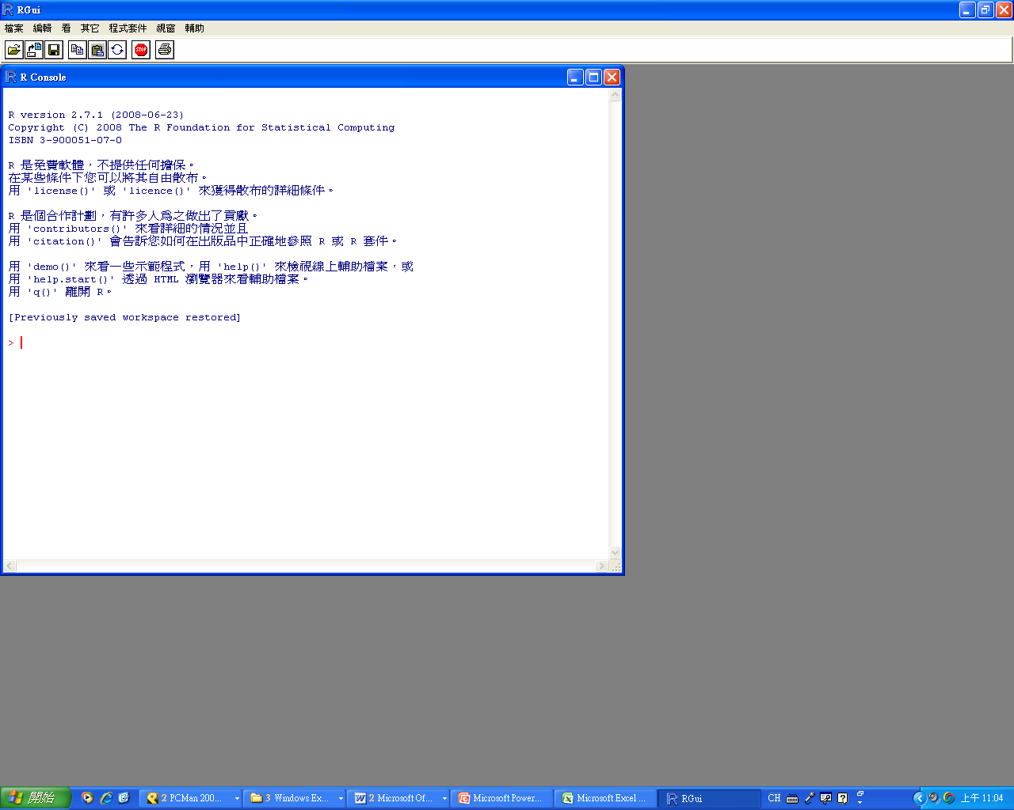

Slide 8
(10+40)/2+3
10^50/10^30
y<-1/sqrt(2*pi)*exp(-1/2)
sigma<-1
mu<-0
x<-2
1/(sqrt(2*pi)* sigma)*exp(-((x - mu)^2/(2*sigma^2)))
x<-rnorm(n=32,mean=80,sd=10)
#產生32個來自平均值為80標準偏差為10的常態分布的隨機數
x
x+5 #向量x中所有的數值+5
x
hist(x) #畫x的直方圖
?Syntax #查詢R基本術語

Slide 9

編寫程式:「檔案」→「建立新的命令稿」 或直接於「>」後編寫
空一行或用分號 「；」 將指令分開
套用已寫好之程式: 「檔案」→「開啟命令稿件」
修改或繼續編寫程式: 「檔案」→「開啟命令稿件」
程式套件(package)載入: 「程式套件」→「載入程式套件」
清理視窗: 右鍵→「清除視窗」
「←」、「→」或「=」表輸入
前面已執行完的指令:「↑」逐一顯示
＋: 程式未完結就換行會顯示「＋」提醒，欲結束按「Esc」
英文字母大小寫視為不同的符號
# 井字號之後為註解，程式不會執行
結束R程式: 直接關閉或指令「q()」

Slide 10

「輔助」→「Html輔助」= help.start()
「輔助」→「R函式」= help() 及 ?
「輔助」→「搜尋輔助」= help.search()
Description: brief description
Usage: for a function, details each of its arguments and the
possible options (with the corresponding default values);
for an operator gives the typical use.
Argument: for a function, details each of its arguments.
Details: detailed description
Value: if applicable, theh type of object returned by the
function or the operator.
See Also: other help pages close or similar to the present one
Examples: some examples which can generally be executed
without opening the help with the function example

Slide 11

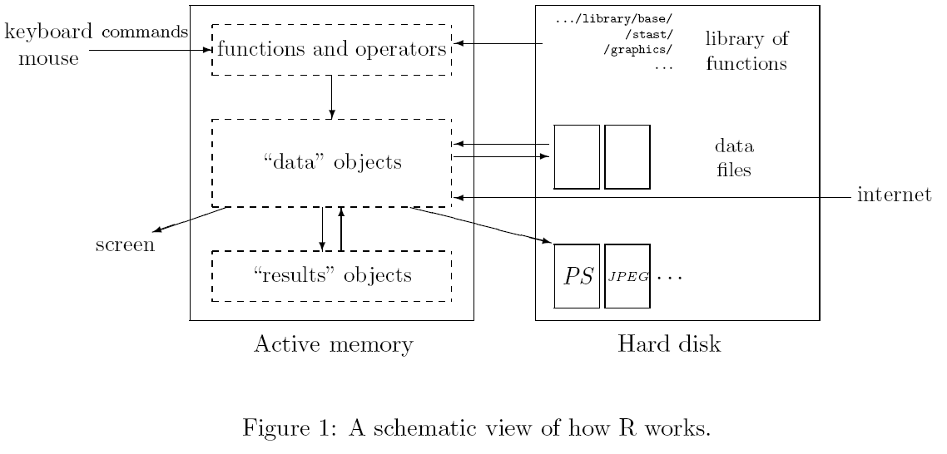
變數(variable),資料(data),函數(function),結果(result)等在R程式運行時皆以物件(object)的形式存於電腦記憶體中。我們可以通過運算子(operators)或函數(function)對物件做操作。

Slide 12

object | Modes | several modes possible in the same object
vector | numeric, character, complex or logical | No
factor | numeric or character | No
array matrix | numeric, character, complex or logical | No
matrix | numeric, character, complex or logical | No
data frame | numeric, character, complex or logical | Yes
ts | numeric, character, complex or logical | No
list | function, expression, … | Yes
所有的物件(objects)都有兩種基本屬性(intrinsic attributes): 格式(mode)與長度(length)
a<-1 ; b<-"sec"; c<-1i ;d<-"TRUE"
mode(a);mode(b);mode(c);mode(d)
ls() #列出所有物件
rm(a) #清除物件a

Slide 13

Arithmetic |  | Comparison |  | Logical
+ | addition | < | lesser than | !x | logical NOT
- | subtraction | > | greater than | x&y | logical AND
* | multiplication | <= | lesser than or equal to | x&&y | id.
/ | division | >= | greater than or equal to | x|y | logical OR
^ | power | == | equal | x||y | id.
%% | modulo | != | different | xor(x,y) | exclusive OR
%/% | integer division
x<-matrix(1:6,2,3) #製造一個2*3的矩陣x，其數值為1到6
x[2,3]==6 # x矩陣第2row第3column的值是否等於6
x[x<=3] # 列出x矩陣內小於或等於3的數值
x[x!=6] # 列出x矩陣內不等於6的數值
x[x<=3 & x!=2] #列出x矩陣內小於或等於3且不等於2的值

Slide 14

function.name(object, argument, option)
函數名稱 物件 指令 選項
#args(function.name) 查詢該函數的指令
數學及簡單函數
sum(),mean(),max(),length()
產生隨機變數
rnorm(),runiform(),rbinom()
初統常用分析函數
t.test(),aova(),lm()

Slide 15

n1:n2, seq(), c(), rep(), sequence()
s1<-1:10 ; s1 #產生一個1到10的序列;
seq(from=1,to=5,length=0.5) #產生一個序列從1到5間隔為0.5的序列;
s2<-c(1,3,5); s2 #產生數值序列1,3,5
s3<-c("a","b","c"); s3 #產生文字序列1,3,5
rep(1,10) #產生數值1重複10次的序列;
rep("M",10) #產生文字序列 重複"M" 10次
sequence(c(3,5)) #產生1到3接連1到5的序列;

Slide 16

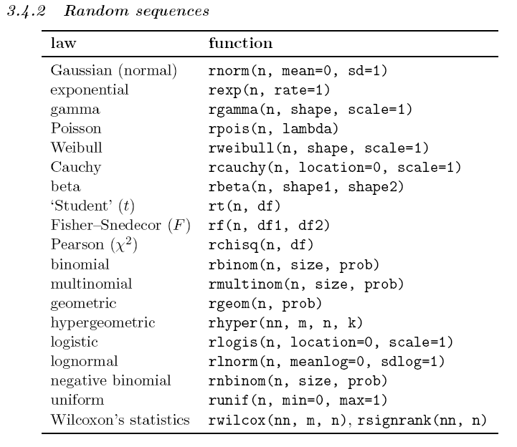

Slide 17
rnorm() → 產生常態分布的隨機變數
dnorm() → probability density
pnorm() → cumulative probability function
qnorm() → the value of quantile
rnorm(n=30,mean=0,sd=1)
dnorm(1)== 1/sqrt(2*pi)*exp(-1/2)
pnorm(1.645, mean=0,sd=1)
qnorm(0.95,mean=0,sd=1)

Slide 18

f1<-factor(1:3); f1;
f2<-factor(1:3,level=1:5); f2; #產生三個因子1,2,3 有五個等級
f3<-factor(rep(1:3,5)); f3;
f4<-factor(c(3,5),level=1:5); f4
gl(3, 5) #產生一組factor, 有3個等級，每個等級重複5次;
gl(3,5,label=c("a","b","c") ) # 同上，另將此三個等級分別命名為"a","b","c";
gl(3,5,length=30)
gl(2,10)
gl(2,1,length=20) #區分不同
expand.grid(h=c(60,80),w=c(100,300),sex=c("Male","Female"))

Slide 19

從Excel建立資料→檔案→存成.csv檔
male | female
176 | 156
168 | 162
175 | 157
181 | 163
177 | 170
165 | 161
172 | 154
170 | 155
173 | 162
169 | 167
186 | 163
163 | 160
175 | 162
174 | 159
169 | 158
170 | 163
172 | 160
176 | 161
172 | 158
171 | 160

Slide 20
輸入外部資料(.txt檔或.csv檔)
read.table()
read.csv() #預設讀取.csv檔
外部輸入資料為data.frame物件
test1<-read.table("c:/test.csv", header=T, sep=",")
#讀取C:\test.csv檔案，有標題，分隔符號為 “,”
test2<-read.csv("c:/test.csv", header=T , col.names=c("M","F"))
#讀取C:\test.csv檔案，有標題，將column 1 ,2分別命名為 “M”及 “F”

Slide 21
data.frame() 自行產生資料框物件
x<-1:4 ; n<-10; M<-c(10,35); y<-2:4
data.frame(x,n)
data.frame(x,M)
data.frame(x,y)
z<-c("a","b","c","d")
data.frame(x,n,row.names=z)

Slide 22

scan() 逐行讀入資料
  讀取外部資料
  直接輸入資料
data2<-scan("c:/test.csv", sep=", " ,skip=1); data2
data3<-scan()
1 2 3 4 5
6 7 8 9 10
data3

Slide 23

將資料存成.txt或.csv檔
write.table()
write.table(file=test2,"c:/test2.csv", sep=",")
#輸出物件test資料框物件到C:\test2.csv

Slide 24

產生矩陣
矩陣操作
m1<-matrix(1,nr=2,nc=3); m1
m2<-matrix(c(1,2,3,4,5,6),nr=2,nc=3); m2
m3<-matrix(c(1,2,3,4,5,6),2,3,byrow=T);m3
m4<-c(1,2,3,4,5,6); dim(m4)
dim(m4)<-c(2,3); m4
cbind(m1,m2)
rbind(m1,m2)
m2[,2] ; m2[2,2]
m5<-matrix(c(2,0,0,2),2,2);
m6<-solve(m5); m6
m5%*%m6
diag(m5); diag(m5)<-3; m5

Slide 25

Expression 為一連串對R有意義的文字所組成物件
x<-3; y<-2.5; z<-1
exp1<-expression(x/(y+exp(z))
exp1
expression(x/(y+exp(z))
eval(exp1)
D(exp1, "x") #對x偏微分
D(exp1, "y")

Slide 26

[ ] index
:: access variables in a name space
@ $ component / slot extraction
attach()
names()
test1<-read.table("c:/test.csv", header=T, sep=",");
test1[1,] ; test1[,2];
test1[,2, drop=F ]
test1[-1,]
test1[test1>=170]

Slide 27

產生2組長度為10的隨機序列，然後將此兩個序列合併成為1*2的矩陣
模擬1組電腦選號的樂透號碼
將2008奧運比賽台灣棒球隊的打擊成績輸入R
輸入後更改陳金鋒的姓名為 “不動的第四棒”
列出打擊率為零的球員，再將其更改為0.01
將更改後的資料框輸出成.csv檔

Slide 28

sum(x) | sum of the elements of x
prod(x) | product of the elements of x
max(x) | maximum of the elements of x
min(x) | minimum of the elements of x
which.max(x) | returns the index of the greatest element of x
which.min(x) | returns the index of the smallest element of x
range(x) | in. than c(min(x),max(x))
length(x) | number of elements of x
mean(x) | mean of the elements of x
median(x) | median of the elements of x
var(x) or cov(x) | variance of the elements of x (calculated on n-1);if x is a matrix or a data frame, the variance-covariance matrix is calculated
cor(x) | correlation matrix of x if it is a matrix or a data frame(1 if x is a vector)
var(x,y) or cov(x,y) | covariance between x and y, or between the columns of x and those of y if they are matrices or data frames
cor(x,y) | linear correlation between x and y, or correlation matrix if they are matrices or data frames

Slide 29
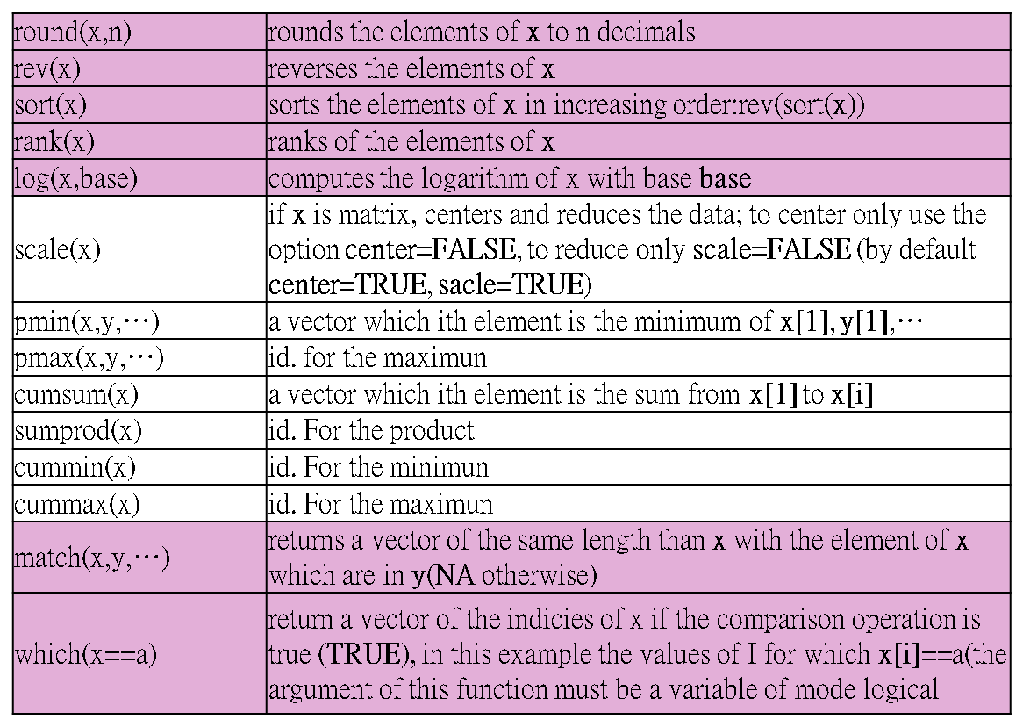

Slide 30
choose(n,k) | computes the combinations of k event among n repetitions = n! / [(n-k)!k!]
na.omit(x) | suppresses the observations with missing data(NA) (suppresses the corresponding line if x is a matrix or a data frame)
na.fail(x) | returns an error message if x contains at least one NA
unique(x) | if x is vector or a data frame, return a similar object but with the duplicate elements suppressed
table(x) | returns a table with the numbers of the differents values of x (typically for integers or factors)
table(x,y) | contingency table of x and y
subset(x,…) | returns a selection of x with respect to criteria (…, typically comparison: x$v1 < 10); if x is a data frame, the option select gives the variables to be kept (or dropped using a minus sign)
sample(x,size) | resample randomly and without replacement size elements in the vector x, the option replace = TRUE allows to resample with replacement

Slide 31

demo(graphics) #展示圖例
High-level plotting function: 產生新的繪圖
Low-level plotting function: 對已繪製完成的圖片增加點,線條或說明
par(): 調整繪圖的參數

Slide 32

plot(x) | plot of the values of x (on the y-axis) ordered on the x-axis
plot(x,y) | bivariate plot of x (on the x-axis) and y (on the y-axis)
sunflowerplot(x,y) | id. but the points with similar coordinates are drawn as a flower which petal number represents the number of points
pie(x) | circular pie-chart
boxplot(x) | box-and-whiskers plot
stripchart(x) | plot of the values of x on a line (an alternative to boxplot() for small sample sizes)
coplot(x~y j z) | bivariate plot of x and y for each value (or interval of values) of z
interaction.plot(f1, f2, y) | if f1 and f2 are factors, plots the means of y (on the y-axis) with respect to the values of f1 (on the x-axis) and of f2 (different curves); the option fun allows to choose the summary statistic of y (by default fun=mean)
matplot(x,y) | bivariate plot of the first column of x vs. the first one of y, the second one of x vs. the second one of y, etc.
dotchart(x) | if x is a data frame, plots a Cleveland dot plot (stacked plots line-by-line and column-by-column)
fourfoldplot(x) | visualizes, with quarters of circles, the association between two dichotomous variables for different populations (x must be an array with dim=c(2, 2, k), or a matrix with dim=c(2, 2) if k = 1)
assocplot(x) | Cohen-Friendly graph showing the deviations from independence of rows and columns in a two dimensional contingency table

Slide 33
mosaicplot(x) | 'mosaic' graph of the residuals from a log-linear regression of a contingency table
pairs(x) | if x is a matrix or a data frame, draws all possible bivariate plots between the columns of x
plot.ts(x) | if x is an object of class "ts", plot of x with respect to time, x may be multivariate but the series must have the same frequency and dates
ts.plot(x) | id. but if x is multivariate the series may have different dates and must have the same frequency
hist(x) | histogram of the frequencies of x
barplot(x) | histogram of the values of x
qqnorm(x) | quantiles of x with respect to the values expected under a normal law
qqplot(x, y) | quantiles of y with respect to the quantiles of x

Slide 34

points(x, y) | adds points (the option type= can be used)
lines(x, y) | id. but with lines
text(x, y, labels,...) | adds text given by labels at coordinates (x,y); a typical use is:plot(x, y, type="n"); text(x, y, names)
mtext(text,side=3, line=0,...) | adds text given by text in the margin specified by side (see axis() below); line specifies the line from the plotting area
segments(x0, y0, x1, y1) | draws lines from points (x0,y0) to points (x1,y1)
arrows(x0, y0, x1, y1, angle= 30, code=2) | id. with arrows at points (x0,y0) if code=2, at points (x1,y1) if code=1, or both if code=3; angle controls the angle from the shaft of the arrow to the edge of the arrow head
abline(a,b) | draws a line of slope b and intercept a
abline(h=y) | draws a horizontal line at ordinate y
abline(v=x) | draws a vertical line at abcissa x
abline(lm.obj) | draws the regression line given by lm.obj (see section 5)
rect(x1, y1, x2,y2) | draws a rectangle which left, right, bottom, and top limits are x1, x2, y1, and y2, respectively

Slide 35
polygon(x, y) | draws a polygon linking the points with coordinates given by x and y
legend(x, y,legend) | adds the legend at the point (x,y) with the symbols given by legend
title() | adds a title and optionally a sub-title
axis(side, vect) | adds an axis at the bottom (side=1), on the left (2), at the top(3), or on the right (4); vect (optional) gives the abcissa (or ordinates) where tick-marks are drawn
box() | adds a box around the current plot
rug(x) | draws the data x on the x-axis as small vertical lines
locator(n, type="n", ...) | returns the coordinates (x; y) after the user has clicked n times on the plot with the mouse; also draws symbols (type="p") or lines (type="l") with respect to optional graphic parameters(...); by default nothing is drawn (type="n")

Slide 36

adj | controls text justification with respect to the left border of the text so that 0 is left-justified, 0.5 is centred, 1 is right-justified, values > 1 move the text further to the left, and negative values further to the right; if two values are given (e.g., c(0, 0)) the second one controls vertical justification with respect to the text baseline
bg | specifies the colour of the background (e.g., bg="red", bg="blue"; the list of the 657 available colours is displayed with colors())
bty | controls the type of box drawn around the plot, allowed values are: "o", "l", "7", "c", "u" ou "]" (the box looks like the corresponding character); if bty="n" the box is not drawn
Cex | a value controlling the size of texts and symbols with respect to the default; the following parameters have the same control for numbers on the axes, cex.axis, the axis labels, cex.lab, the title, cex.main, and the sub-title, cex.sub
col | controls the colour of symbols; as for cex there are: col.axis, col.lab, col.main, col.sub
font | an integer which controls the style of text (1: normal, 2: italics, 3: bold, 4: bold italics); as for cex there are: font.axis, font.lab, font.main, font.sub
las | an integer which controls the orientation of the axis labels (0: parallel to the axes, 1: horizontal, 2: perpendicular to the axes, 3: vertical)

Slide 37
lty | controls the type of lines, can be an integer (1: solid, 2: dashed, 3: dotted, 4: dotdash, 5: longdash, 6: twodash), or a string of up to eight characters (between "0" and "9") which specifies alternatively the length, in points or pixels, of the drawn elements and the blanks, for example lty="44" will have the same effet than lty=2
lwd | a numeric which controls the width of lines
mar | a vector of 4 numeric values which control the space between the axes and the border of the graph of the form c(bottom, left, top, right), the default values are c(5.1, 4.1, 4.1, 2.1)
mfcol | a vector of the form c(nr,nc) which partitions the graphic window as a matrix of nr lines and nc columns, the plots are then drawn in columns (see section 4.1.2)
mfrow | id. but the plots are then drawn in line (see section 4.1.2)
pch | controls the type of symbol, either an integer between 1 and 25, or any single character within "" (Fig. 2)
ps | an integer which controls the size in points of texts and symbols
pty | a character which specifies the type of the plotting region, "s": square, "m": maximal
tck | a value which specifies the length of tick-marks on the axes as a fraction of the smallest of the width or height of the plot; if tck=1 a grid is drawn
tcl | id. but as a fraction of the height of a line of text (by default tcl=-0.5) xaxt if xaxt="n" the x-axis is set but not drawn (useful in conjunction with axis(side=1, ...))
yaxt | if yaxt="n" the y-axis is set but not drawn (useful in conjunction with axis(side=2, ...))

Slide 38

?Control
x<-numeric(10)
for(i in 1:10)
{
x[i]<-i*rnorm(1,mean=0,sd=5)
}
x
for(i in 1:10)
{
if (x[i]<0)
{x[i]<-0}
else
{x[i]<-1}
}
fun<-function(x,mu,sigma)
{ 1/(sqrt(2*pi)* sigma)*exp(-((x - mu)^2/(2*sigma^2))) }
fun(1,0,1)

Slide 39

阿匾將錢匯往國外100次，且其中有20次匯往英屬維京群島，若檢方隨機抽查阿匾的10次匯款紀錄，則: 至少檢查到3筆匯往國外的紀錄的機率為?
binomial<-function(x,n,p)
{choose(n,x)*p^x*(1-p)^(n-x)}
p<-20/100
n<-10
sum(binomial(3:10,n,p))
binomial(2,10,0.2)
dbinom(2,10,0.2)
1-pbinom(2,10,0.2)

Slide 40
假設南韓人與臺灣人的平均壽命分別為75歲及80歲，標準偏差均為10， 今分別隨機挑出30名南韓人與台灣人(男女各半)，試作t-test 比較南韓人與台灣人平均壽命是否有差異?
T<-rnorm(30,mean=80,sd=10)
K<-rnorm(30,mean=75,sd=10)
sex<-c(rep("Man",15),rep("Female",15))
data1<-data.frame(sex,T,K)
ttest1<-t.test(T,K,alternative="two.sided",var.equal=T,conf.level=0.95)
print(ttest1)
ttest2<-t.test(T,K,alternative="greater",var.equal=T,conf.level=0.95)
print(ttest2)
ttest3<-t.test(T~sex,alternative="two.sided",var.equal=T,conf.level=0.95)
#注意 taiwan~sex 表示taiwan這向量內的值根據sex因子分類做t-test
print(ttest3)

Slide 41
迴歸分析
regression<-function(x,y)
{
ex.lm<-lm(y~x)
print(summary(ex.lm))
print(anova(ex.lm))
win.graph()
plot(x,y)
abline(lm(y~x))
res<-ex.lm$residuals #residual plot
yhat<-predict(ex.lm)
win.graph()
plot(yhat,res,main="residuals against fit value")
abline(h=0)
win.graph()
qqnorm(res)
qqline(res)
}
x<-rnorm(20)
y<-2*x+rnorm(20)
regression(x,y)

Slide 42



Slide 43
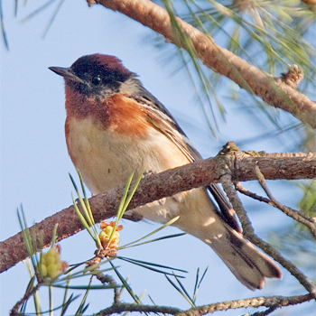
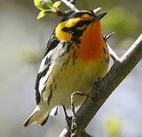
Bay-breasted warbler
栗胸林鶯
Blackburnian warbler
橙胸林鶯

Slide 44
New York Times, january 6 2009.
Data Analysts Captivated by R’s Power

Slide 45


